Slide 1
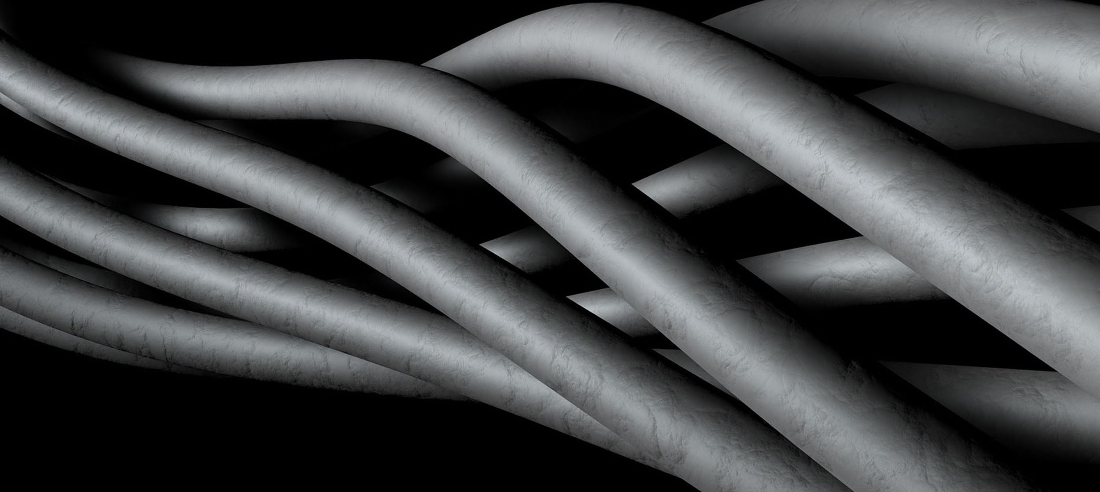

Custom Wire and Cable Harness Assemblies
Global Headquarters 5822 N Henkel Rd, Howard City, MI 49329

Slide 2
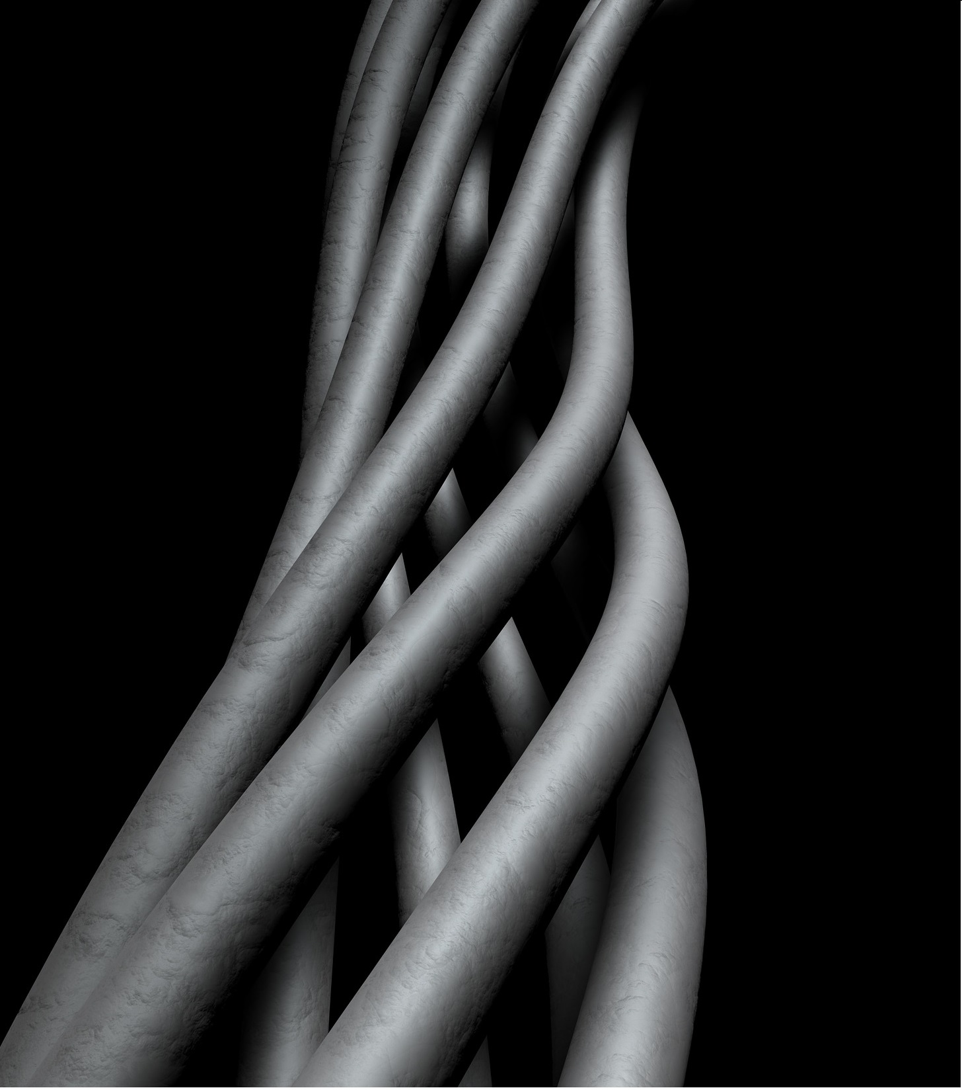

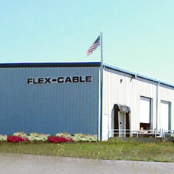
For over 55 years, FLEX-CABLE has been supplying custom cable assemblies and automation to the welding and steel mill industries.
As a manufacturer and global supplier of cable products, bus bar technology, metal fabrication and stampings. FLEX-CABLE is a worldwide leader in engineering and production of the most advanced products.
Manufacturing Headquarters
5822 N Henkel Rd
Howard City, MI 49329
Corporate Headquarters
450 N Old Woodward
Birmingham, MI 48009
800 245.3539
www.flexcable.com
55+ years, resistance welding
30+ years, custom cable assembly
18+ years, robot dress
DUNS# 55-7363905
ISO9000, ISO 13485 and TS16949 certifications
Proven components
In plant support
Large project support
Made in USA, Hub Zone certified
2

Slide 3

Customer Philosophy
Customer Feedback and Retention
Customer Service and Account Management
Customer Experience
Research & Development and Application Engineering
Product Management and Quality Control
2

Slide 4
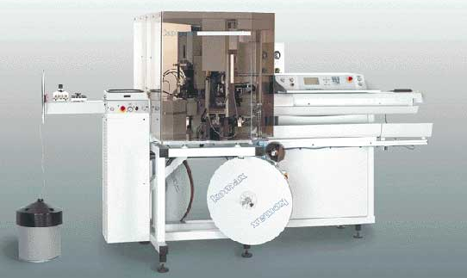
Flex-Cable works closely with you from the design phase through finished product.
Our experienced staff puts a wealth of industry knowledge into every wire and cable harness assembly solution.
Flex-Cable can help you produce or recreate a wire harness assembly to optimize productivity and boost efficiency.
Prototype, production and rapid development services available.
Exceptional Assembly and Design

Slide 5
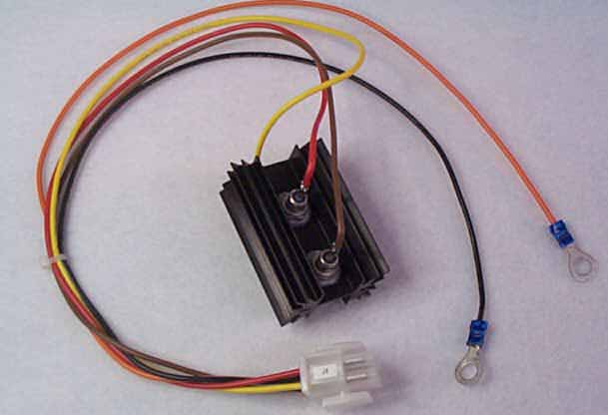
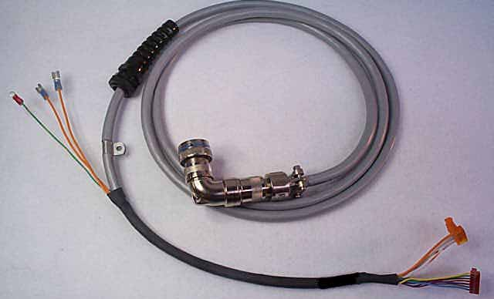
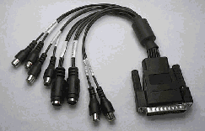
Services and Capabilities
Data transmission cables
Medical grade cables
Instrumentation cables
Custom overmolding
Ribbon cables
Wire leads and sets
Custom assembly
Braiding and Twisting
Automated cut, strip, and terminating equipment ensures precision
Crimp Force Monitoring, through the use of Crimp Force Analysis (CFA)
Creative engineering and design services
100% quality testing and verification (Zero Defects)
After-market replacement design
Prototype, production and rapid development

Slide 6
Quality Inspection
All manufactured cable assemblies and wiring harnesses are 100% tested to your specifications.
Electronic programmable testing
Visual inspection documented
Quality procedures date code
Lot number protection
Certificate of compliance
Incoming parts verification and inspection
Process metrics inspection monitoring
Wire termination pull force verification
CQM statistical measurements
Crimp force measurements
Crimp height measurements
GOOD Crimp Curve
1000
800
600
Spring-back area of curve used to
determine crimp height
FORCE
400
200
4000
3500
3000
2500
2000
1500
1000
500

Slide 7
Industry Served
We design and manufacture for the following markets:
Automotive
Medical
Defense
Industrial
Agriculture
Power Supply Systems
Test and Measurement Systems
Need something you don’t see here?
We can do that too!
We specialize in customized projects!

Slide 8
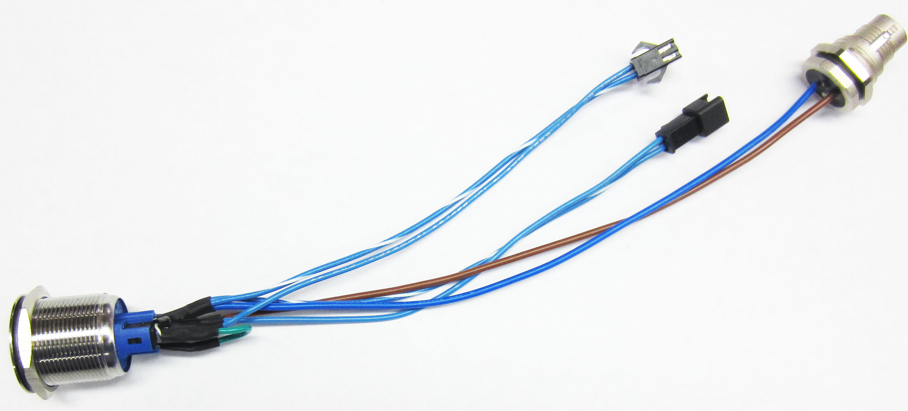
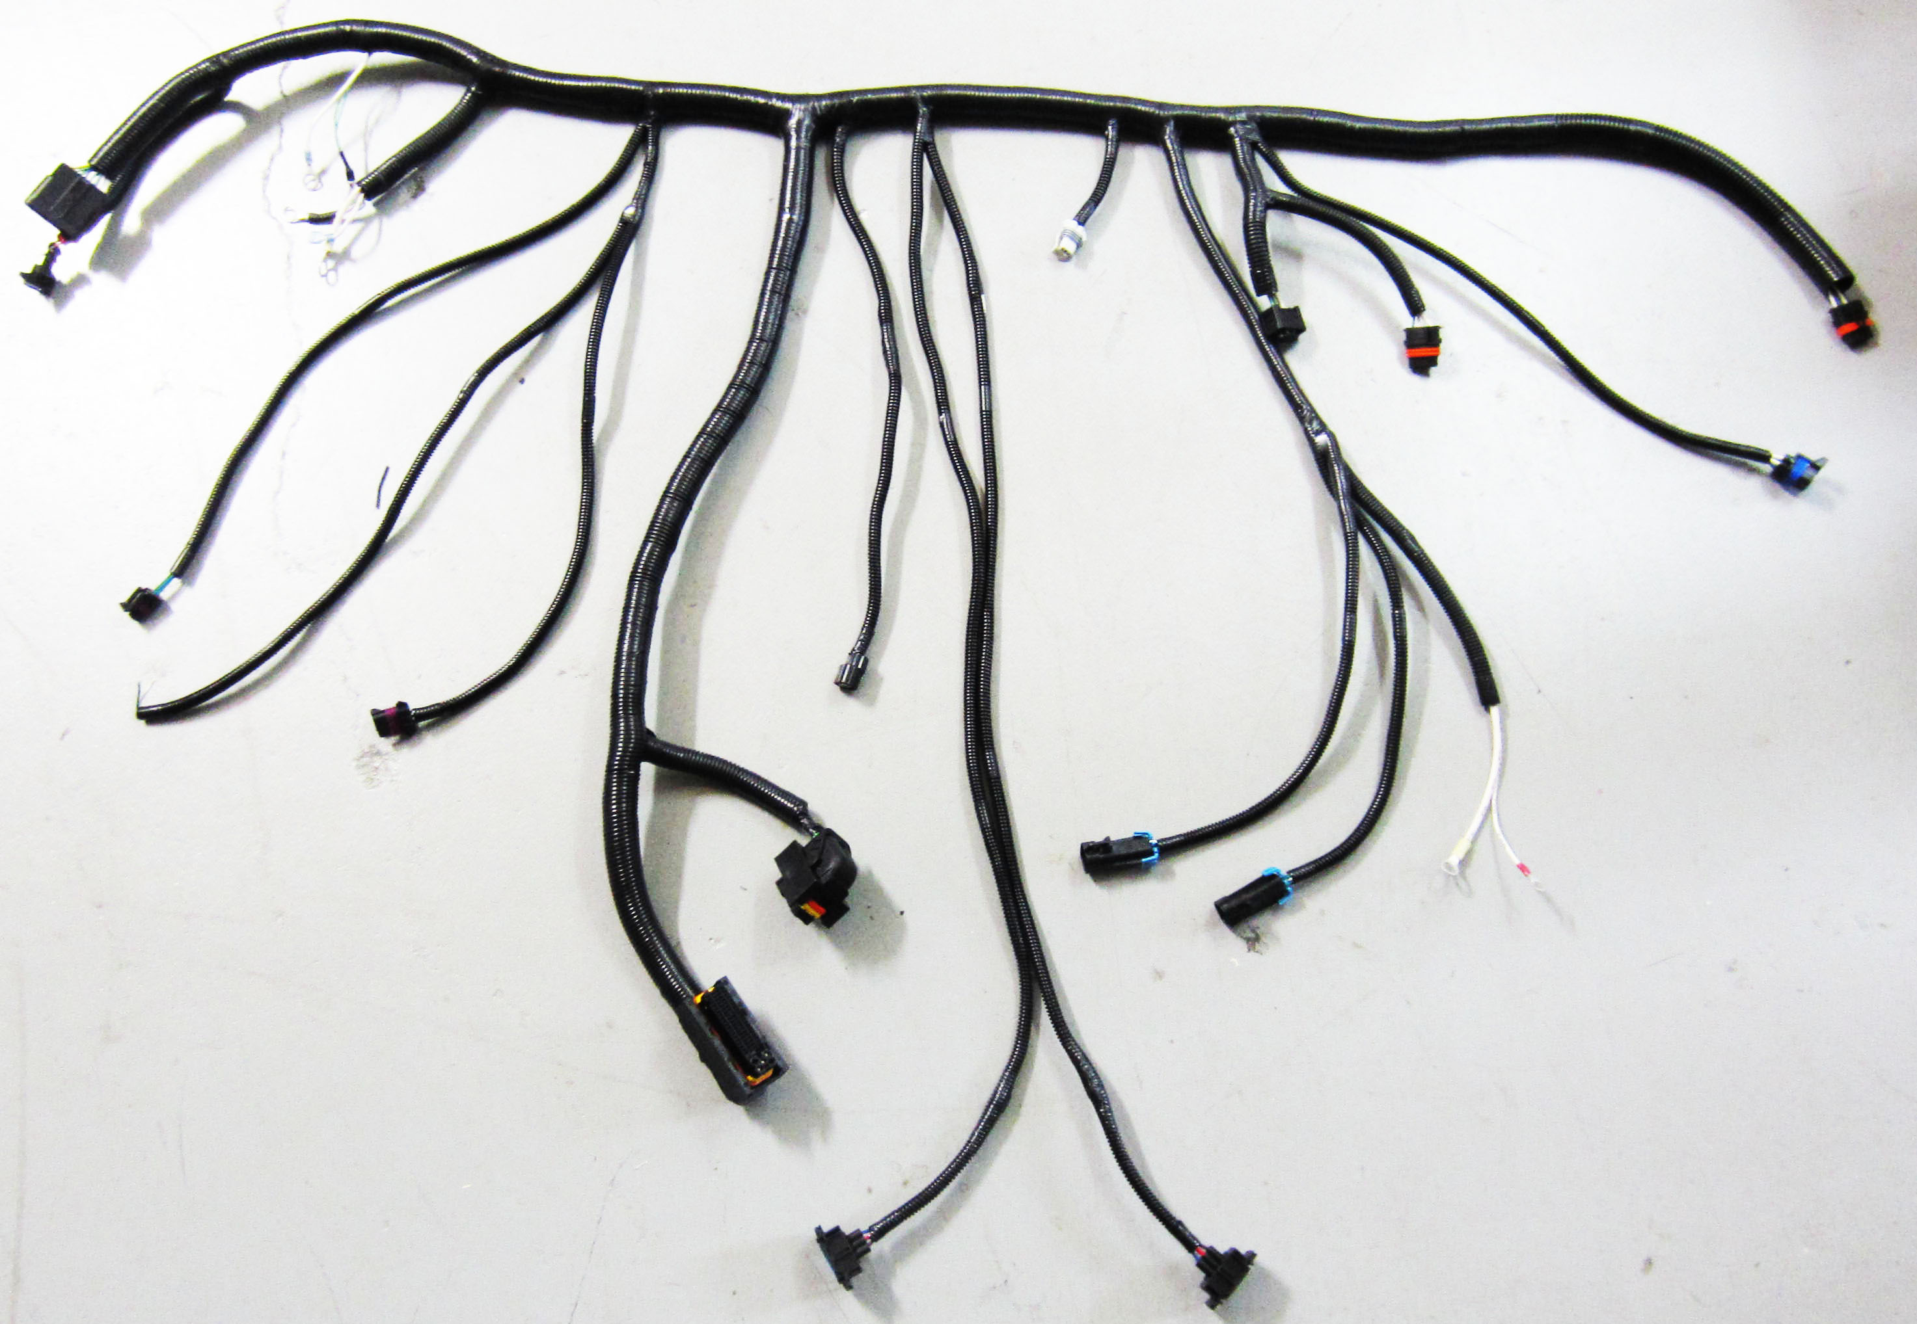
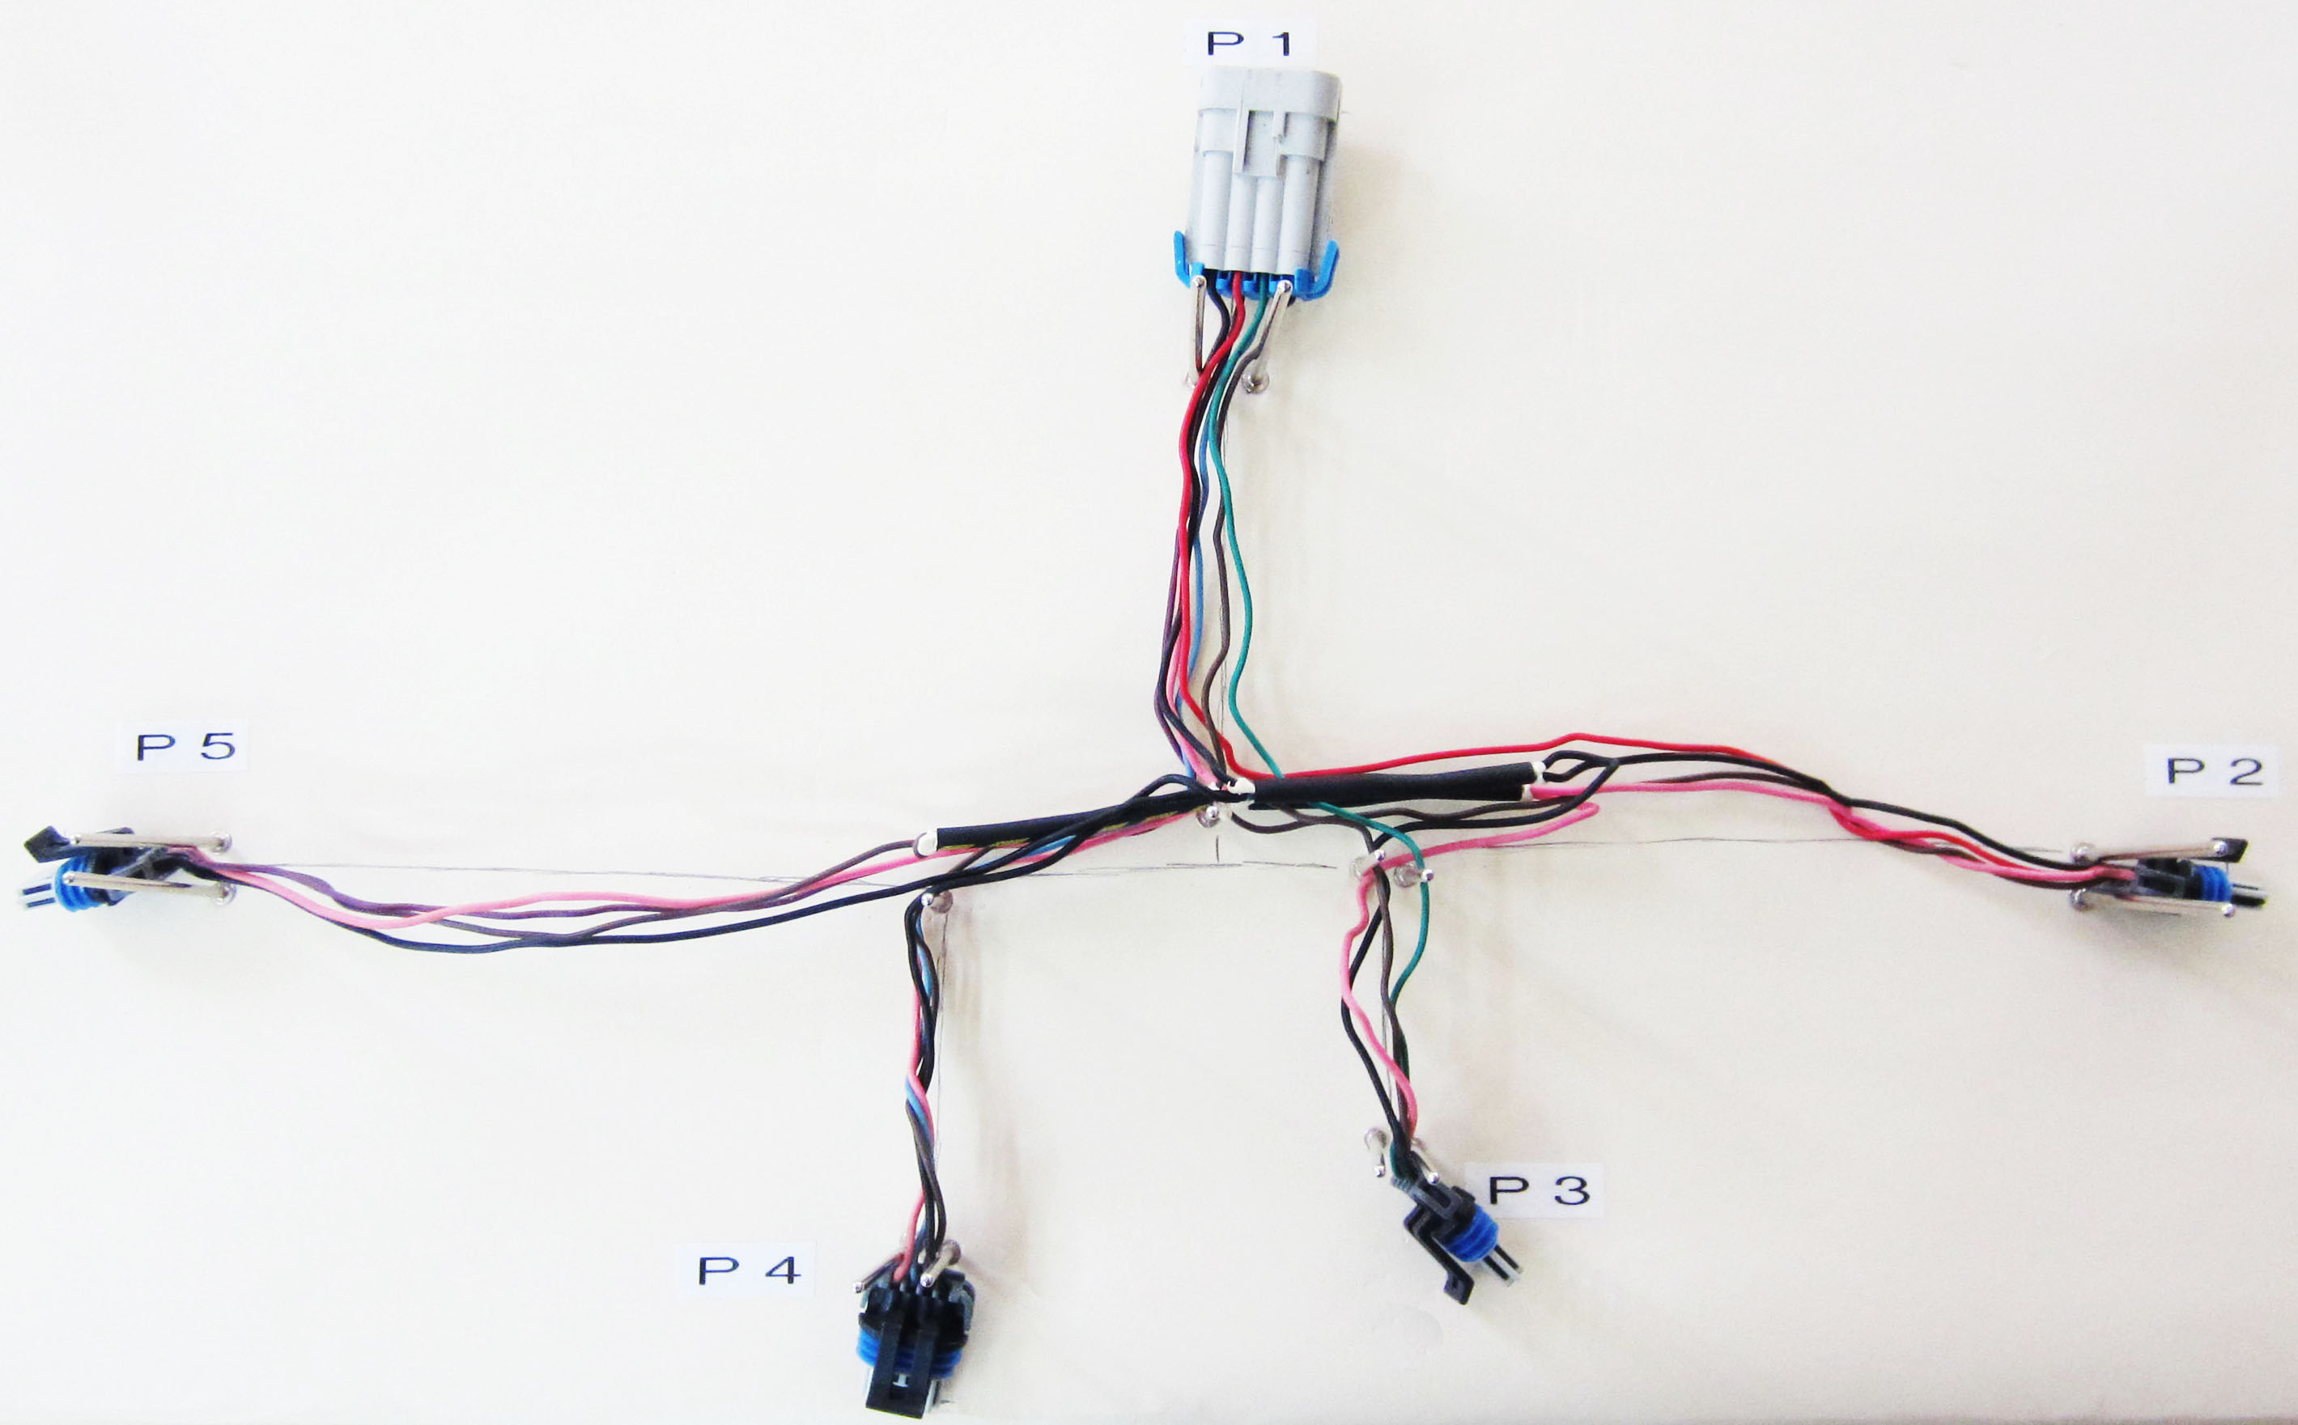
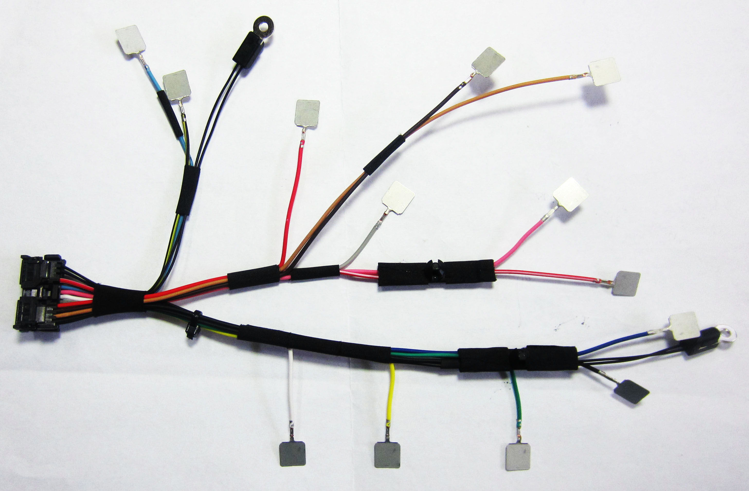
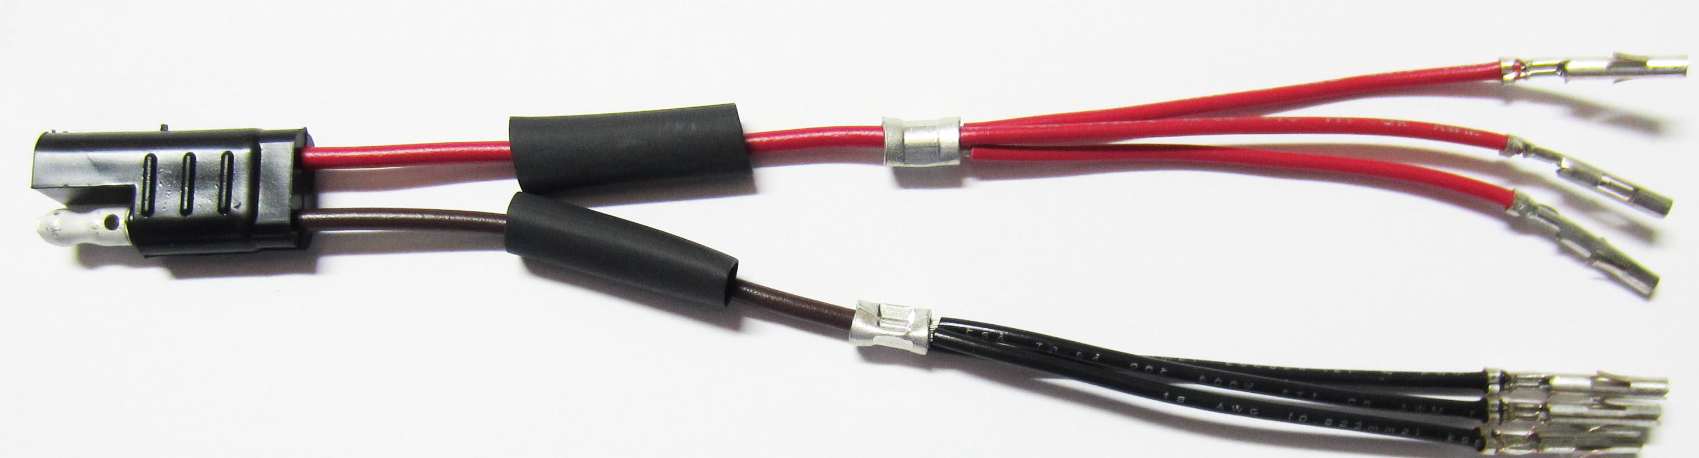


Custom Designs to fit every need.
We’re certified!
Complex Designs to Simplify Your Processes

Slide 9









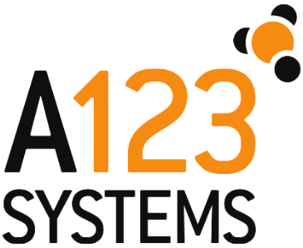




Long term Relationships

